Slide 1
How Show Recommendations In Netflix Affect User Churn Rate
Presentation by Adrian Centeno

Slide 2

The Business Problem

Slide 3

The Business Problem – NETFLIX Facts
One of the most dominant streaming platforms up until this day.
One of the most innovative and technologically advanced.
Has garnered a variety of original content itself that won many awards.
O’Brien, C. (2025, August 25). The unstoppable success of Netflix. Digital Marketing Institute. https://digitalmarketinginstitute.com/blog/the-unstoppable-success-of-netflix

Slide 4
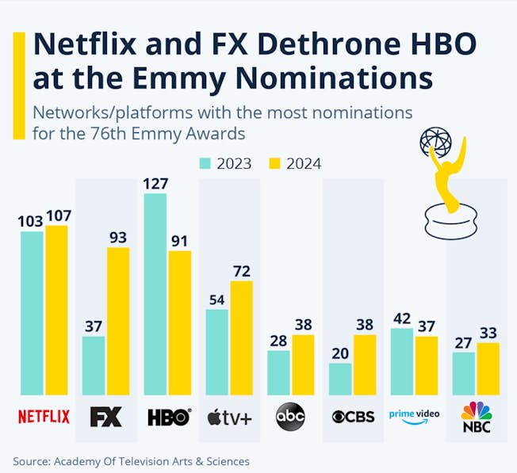
The Business Problem – NETFLIX Facts
“This image shows the streaming giant winning more nominations for the 76th Primetime Emmy Awards, winning 107 nominations, up from 103 in 2023. While HBO was relegated to third place for the first time since 1995.”
Seen here Netflix is a fierce competitor winning multiple nominations
O’Brien, C. (2025, August 25). The unstoppable success of Netflix. Digital Marketing Institute. https://digitalmarketinginstitute.com/blog/the-unstoppable-success-of-netflix

Slide 5
The Business Problem – What makes them Different
Is it:
  Their marketing?
  Their content?
  Or their technology?
Let's focus and dive in specifically into their Technology.

Slide 6
The Business Problem – What makes them Different
One of the key differences of what makes Netflix unique is how they tailor to the customer’s preferences
- Particularly show recommendations based of your show history and your searches
But is this in any way correlated?
Does this spell the difference between failure and success?

Slide 7
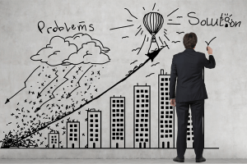
Our Approach

Slide 8
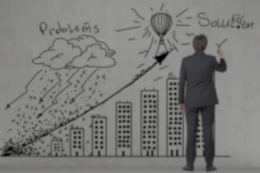
Our Approach
Using AI we can actually find the connection between show recommendations to users and Netflix’s churn rate!
Though a simple solution, it answers the real question of can the right shows recommended to viewers help retain customers?
Churn Rate - the annual percentage rate at which customers stop subscribing to a service or employees leave a job.

Slide 9
Our “Technical” Approach
We collected sample data from online to be used as our sample dataset.
Then a Churn Predictive Model has been created with AUC-ROC as its primary metrics.
Wadood, A. (2025, July 5). Netflix customer churn dataset(upvote if you like). Kaggle. https://www.kaggle.com/datasets/abdulwadood11220/netflix-customer-churn-dataset/data

Slide 10

Results & Findings

Slide 11

Results & Findings
For a proper model to work multiple models were tested such as Logistic Regression, Decision Tree, and Random Forest.
This is recommended as we are trying to find the model that yields the highest (closest to 1.0) AUC-ROC.
Remember!
The higher and closer the AUC-ROC to 1.0, the more accurate the model is.

Slide 12
Results & Findings – Model Results
Base on the results, it seems that out of all models Random Forest came out as the best
Despite Random Forest being the highest, on average we can already see a clear connection between churn rate and shows being recommended.
Model | Result
Logistic Regression | 0.94569
Decision Tree | 0.96431
Random Forest | 0.97184

Slide 13
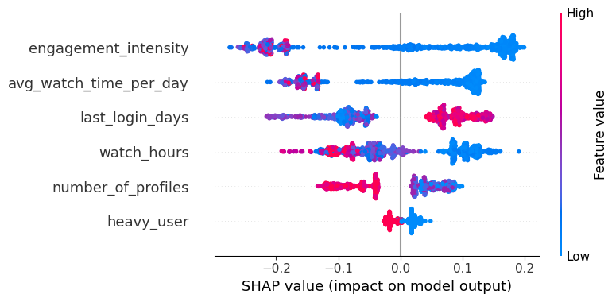
Results & Findings – SHAP Summary Plot
To further understand the results we have a SHAP Summary Plot
SHAP Summary Plot – visualization tool used in machine learning providing an overview of how different features influence the model's predictions across an entire dataset helping understand which features matter most, the direction of their impact, and the variability of their effect.

Slide 14
Results & Findings – SHAP Summary Plot
Understanding the plot we first look at the listed features on the left.
This is sorted from most impactful to the least (top to bottom).
Based on the plot, the engagement_intensity is the top most feature.
This is the user’s watch hours given within the time of their last login day.
Simply put, how often they use Netflix to watch their shows

Slide 15
Results & Findings – SHAP Summary Plot
The SHAP value on the bottom shows how that feature impacts the probability of churning.
The higher they are the higher probability to churn and vice versa.
The color blue to red is for the feature value. The redder dots to the right greatly increase the model’s prediction.
While the blue on the left greatly decrease the model’s prediction.

Slide 16
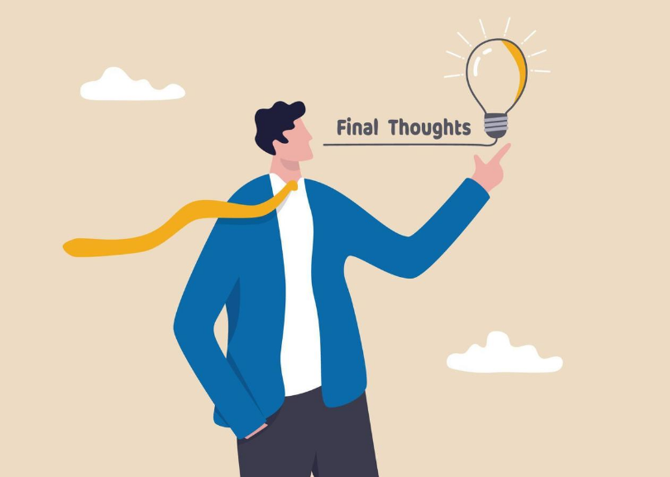
Final Conclusion

Slide 17
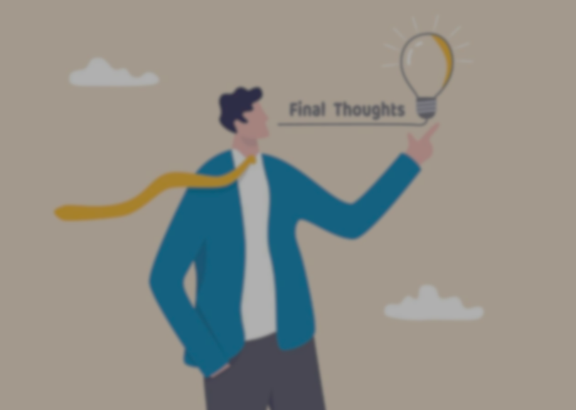
Final Conclusion & Recommendation
Show recommendations greatly impacts the user churn rate in Netflix.
With that we can focus on the business steps on how to improve on the show recommendations to the users in a way that the experience is entirely better.

Slide 18
Final Conclusion & Recommendation
Moving forward:
We can choose to further add customization by giving the users quick surveys or single question quizzes which would later help make better predictions of what shows to recommend.
Removing the region lock for certain shows and movies and instead base the content on what the majority of users in a similar location are watching and or recommending.
Bringing in and accepting popular demands of the customer given there is a big demand for that particular show or movie.

Slide 19
Some people call this artificial intelligence, but the reality is this technology will enhance us. So instead of artificial intelligence, I think we’ll augment our intelligence.
—Ginni Rometty
END
Background images are all taken from Google images.

